Slide 1
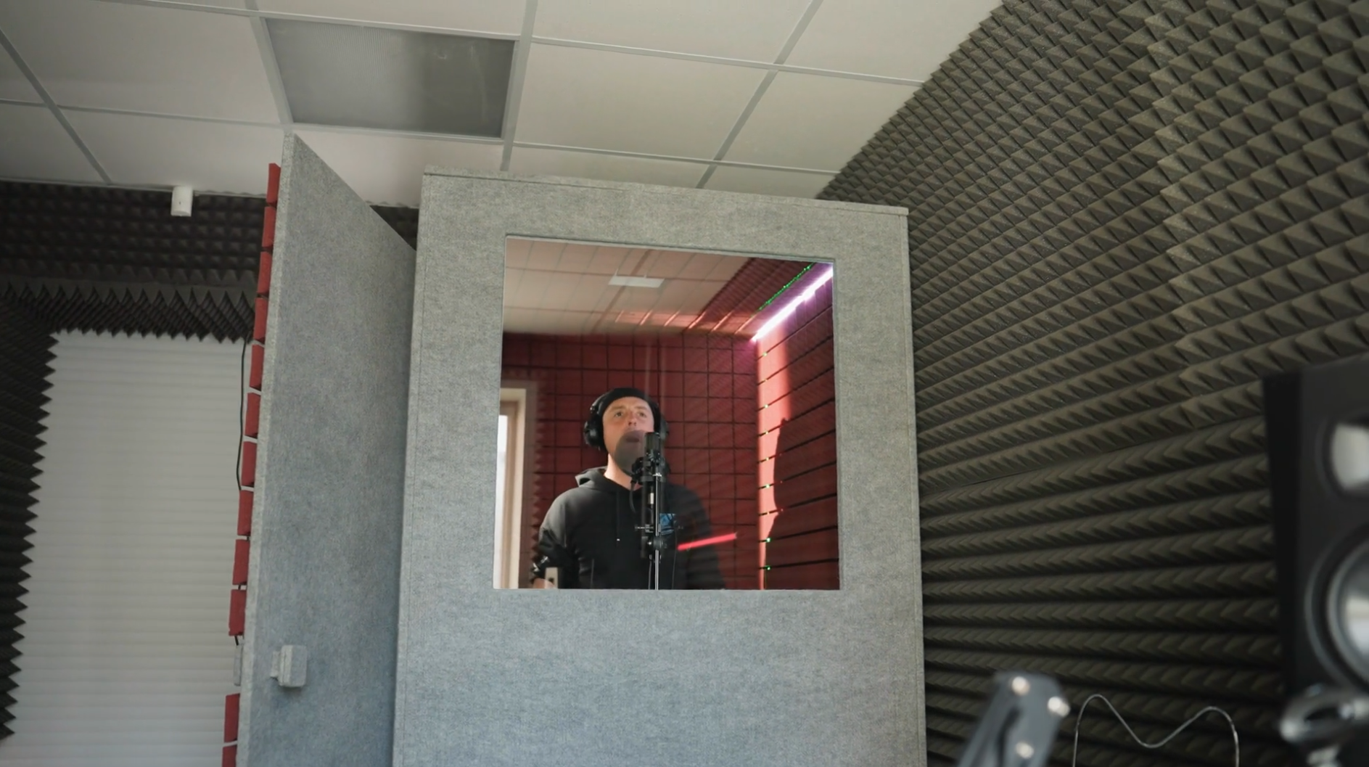
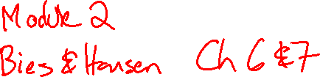
Acoustic Enclosures
Room modes
Tyler Dare

Slide 2
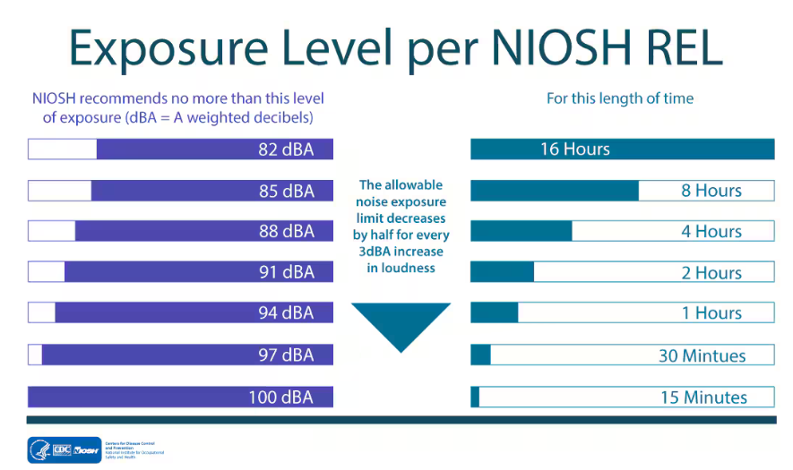
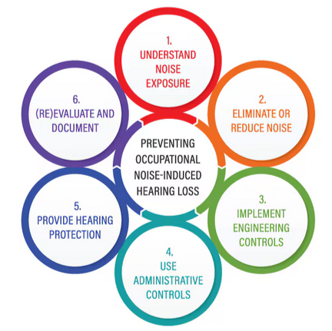
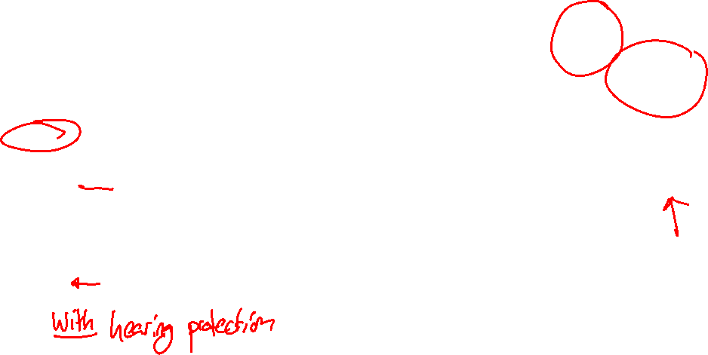
National Institute for Occupational Safety and Health (NIOSH)

Slide 3
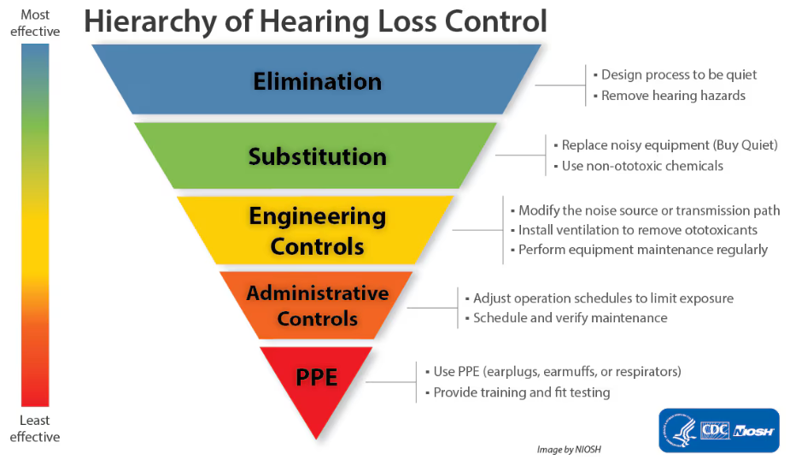
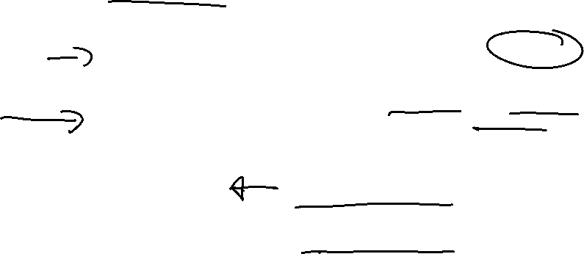
National Institute for Occupational Safety and Health (NIOSH)

Slide 4
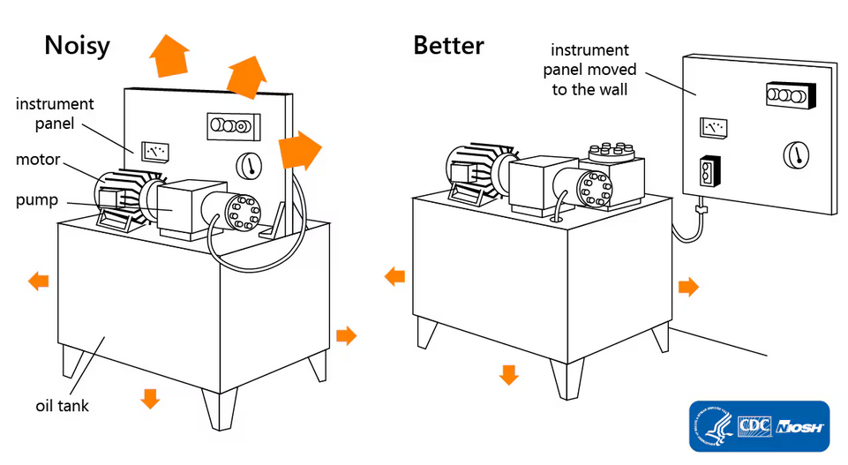
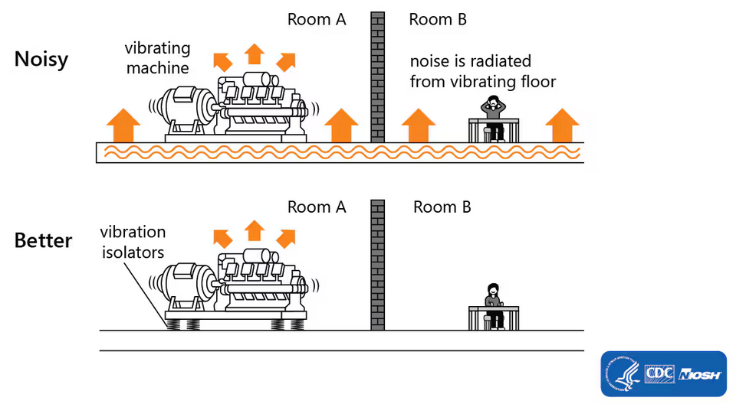
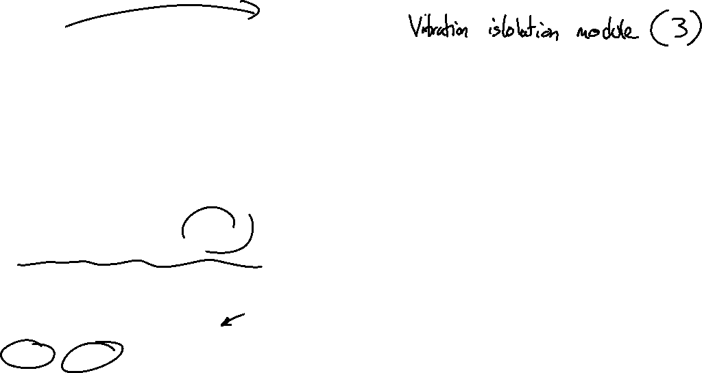
National Institute for Occupational Safety and Health (NIOSH)

Slide 5
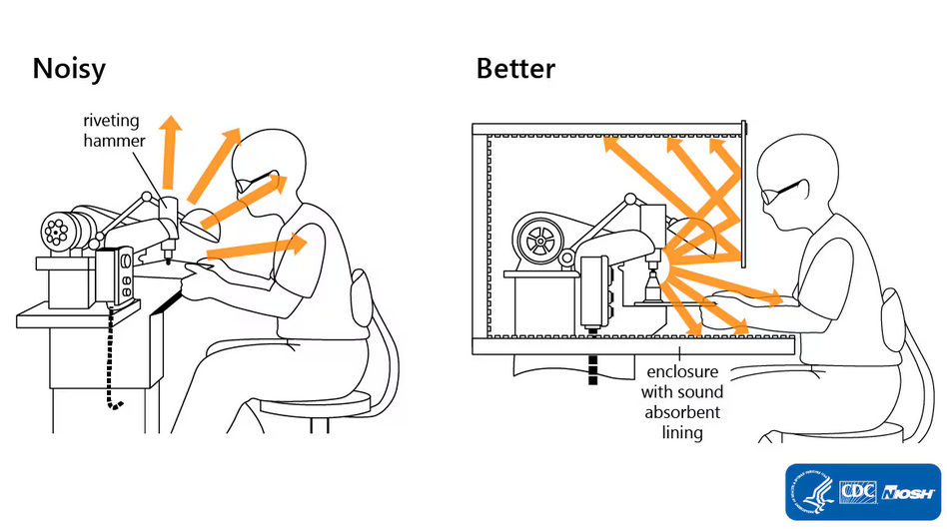
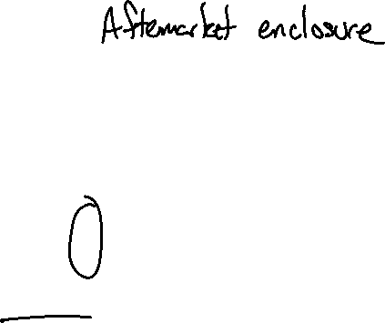
National Institute for Occupational Safety and Health (NIOSH)

Slide 6
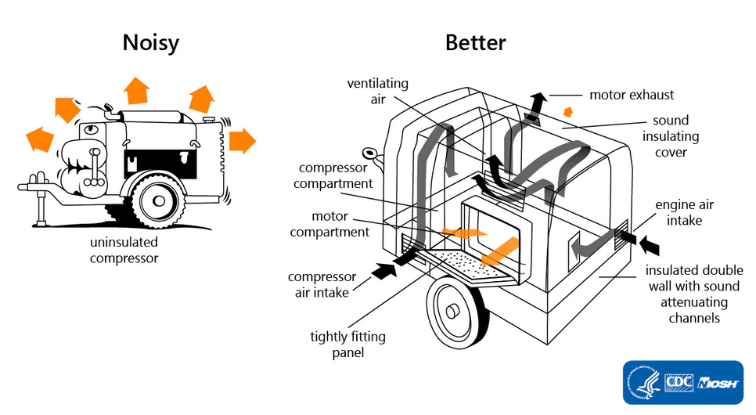
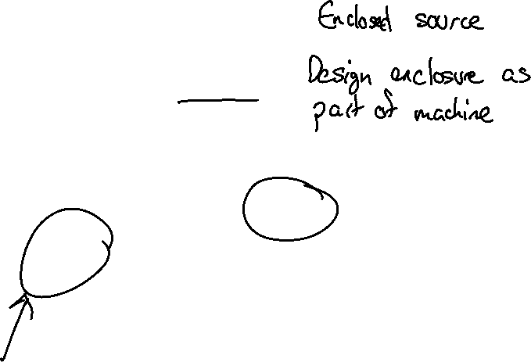
National Institute for Occupational Safety and Health (NIOSH)

Slide 7
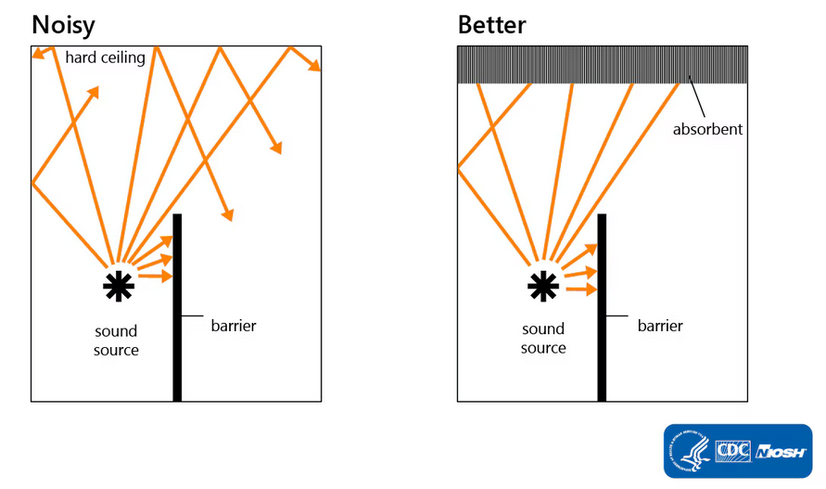
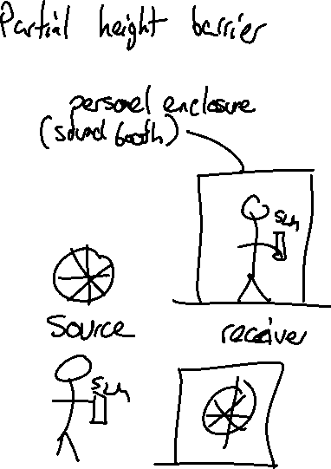
National Institute for Occupational Safety and Health (NIOSH)

Slide 8
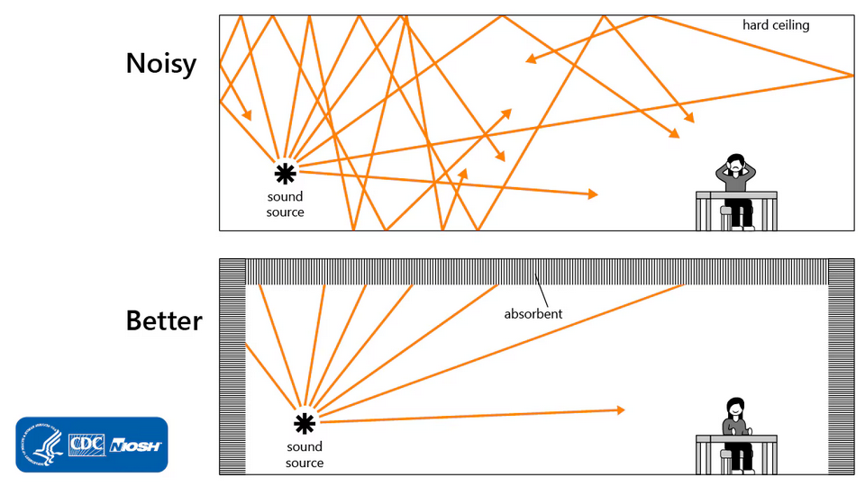
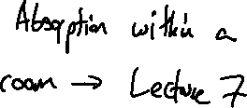
National Institute for Occupational Safety and Health (NIOSH)

Slide 9
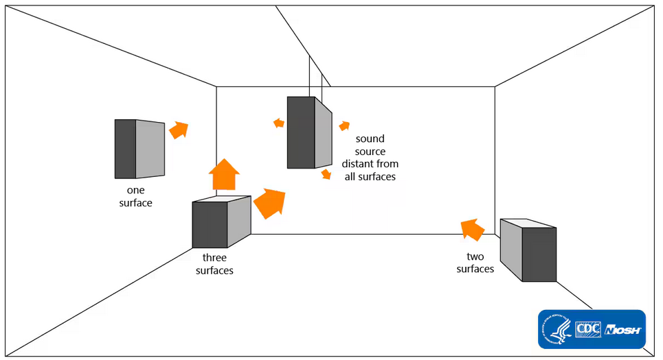
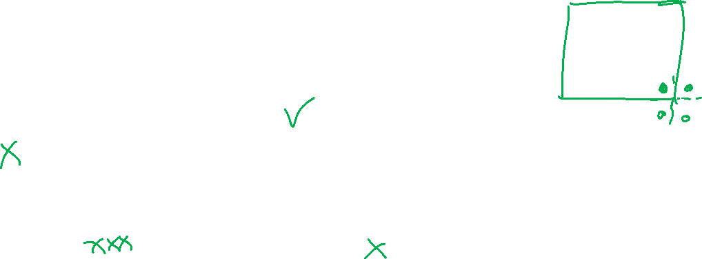
National Institute for Occupational Safety and Health (NIOSH)

Slide 10
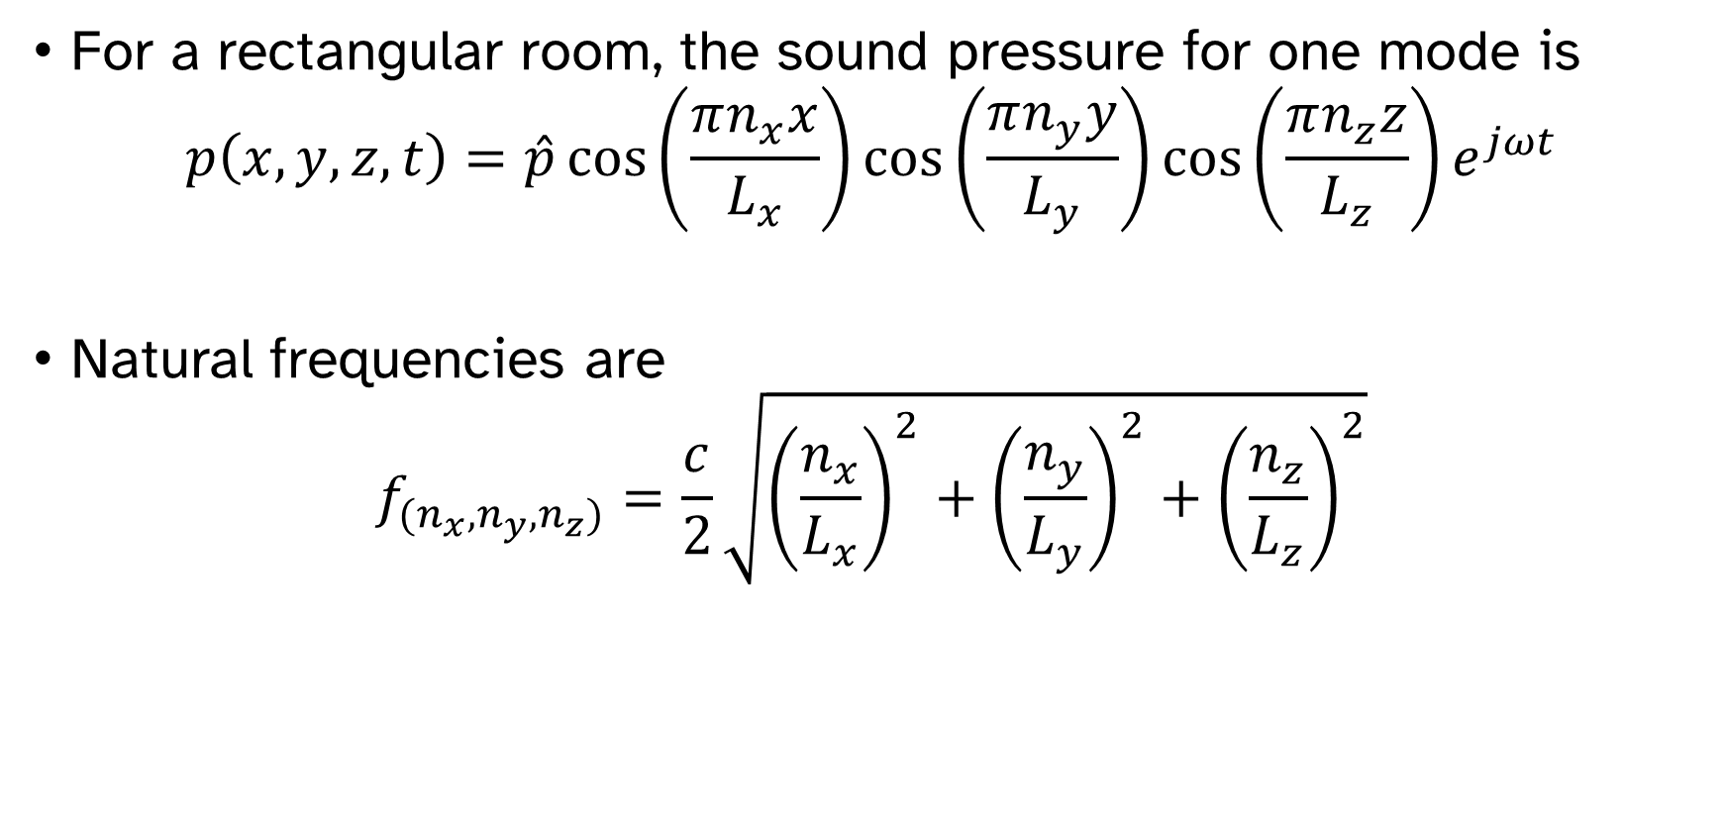
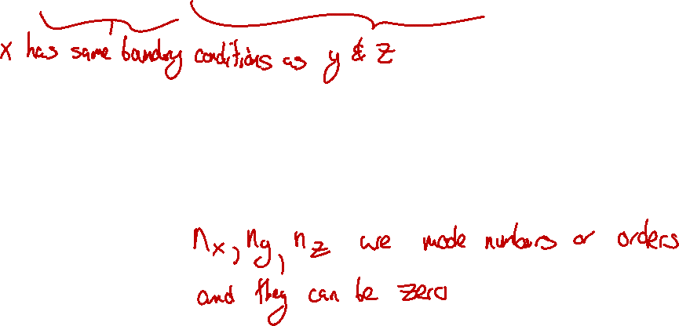
Modes of rectangular rooms
For a rectangular room, the sound pressure for one mode is
$$p\left(x,y,z,t\right)=\hat{p}\cos\left(\frac{πn_{x}x}{L_{x}}\right)\cos\left(\frac{πn_{y}y}{L_{y}}\right)\cos\left(\frac{πn_{z}z}{L_{z}}\right)e^{jωt}$$
Natural frequencies are
$$f_{(n_{x}, n_{y},n_{z})}=\frac{c}{2}\sqrt{{\left(\frac{n_{x}}{L_{x}}\right)}^{2}+{\left(\frac{n_{y}}{L_{y}}\right)}^{2}+{\left(\frac{n_{z}}{L_{z}}\right)}^{2}}$$

Slide 11

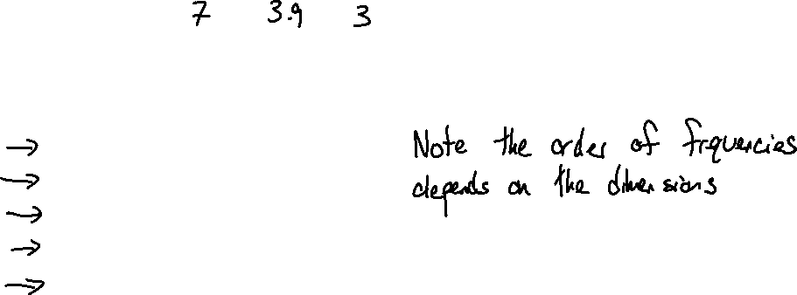
Modes of rectangular rooms
What are the first few natural frequencies for a room with dimensions 7 m by 3.9 m by 3 m?
$$f_{(n_{x}, n_{y},n_{z})}=\frac{c}{2}\sqrt{{\left(\frac{n_{x}}{L_{x}}\right)}^{2}+{\left(\frac{n_{y}}{L_{y}}\right)}^{2}+{\left(\frac{n_{z}}{L_{z}}\right)}^{2}}$$
Mode number | Frequency, Hz
(0,0,0) | 0
(1, 0, 0) | 24
(0,1,0) | 44
(2,0,0) | 49
(1,1,0) | 50
(0,0,1) | 57

Slide 12
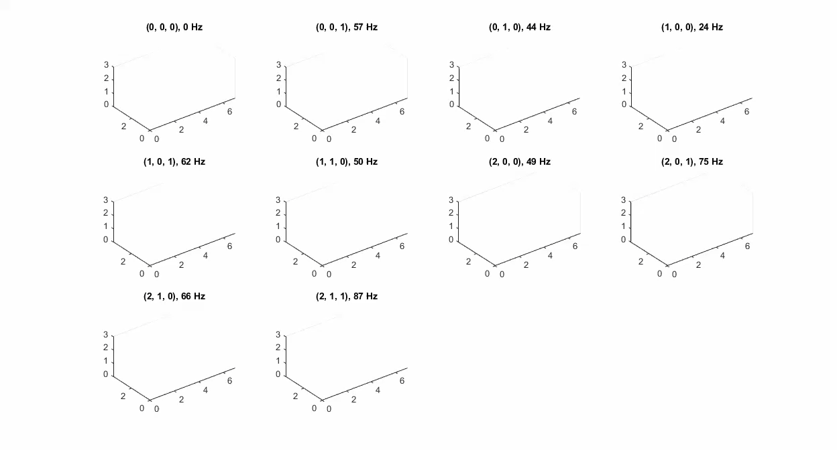
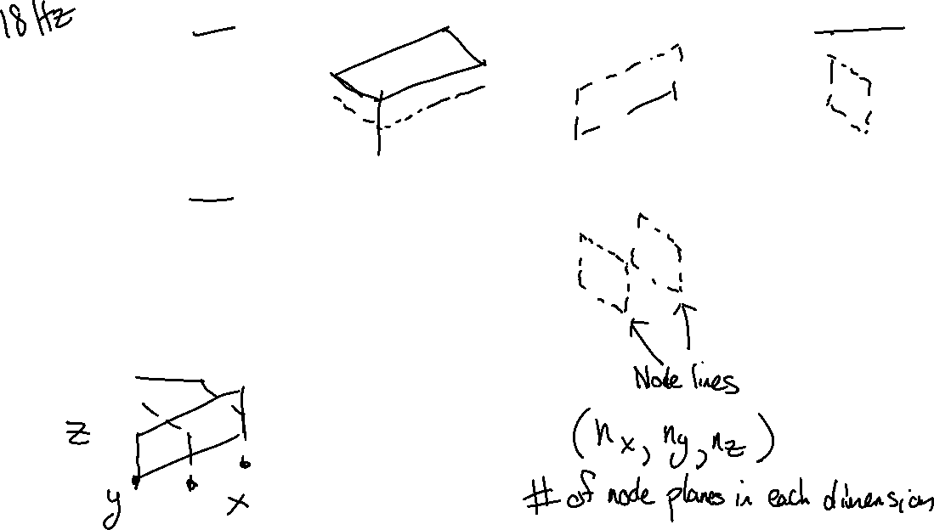

Slide 13
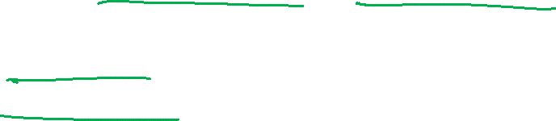
Modal excitation
A mode can be excited at any frequency.
In general, all modes respond at all frequencies.
How much a mode is excited depends on
Frequency matching
Spatial matching

Slide 14
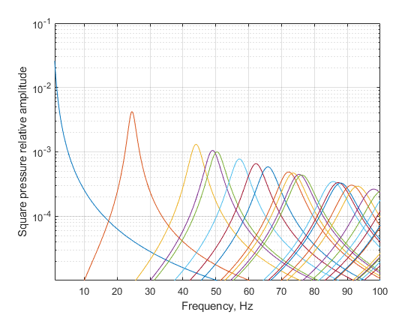
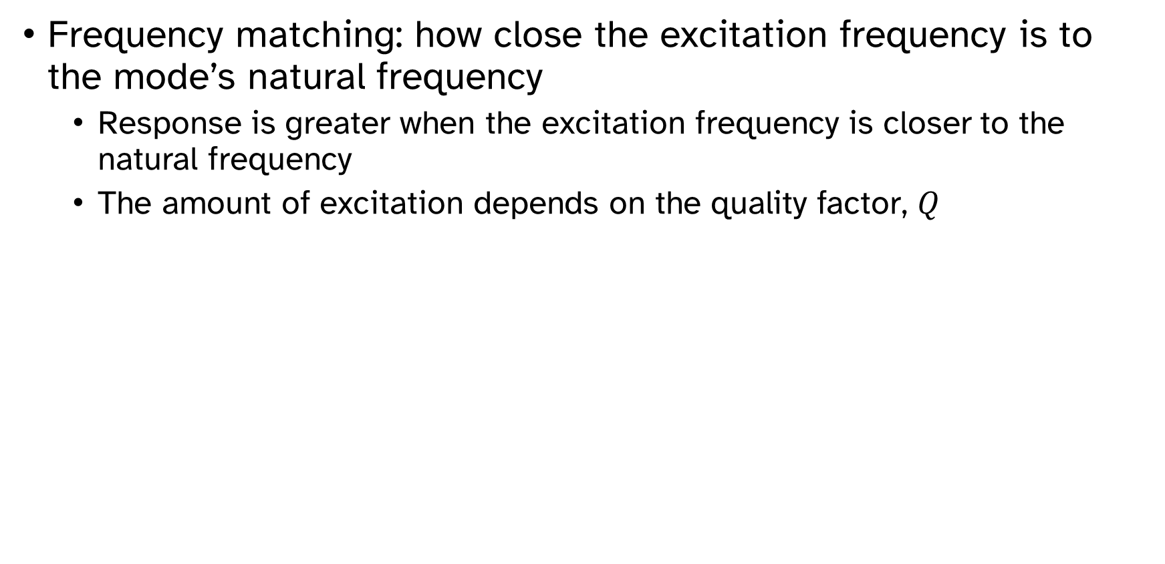
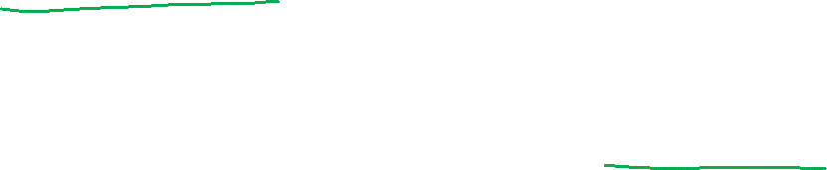
Model excitation
Frequency matching: how close the excitation frequency is to the mode’s natural frequency
Response is greater when the excitation frequency is closer to the natural frequency
The amount of excitation depends on the quality factor, $Q$

Slide 15
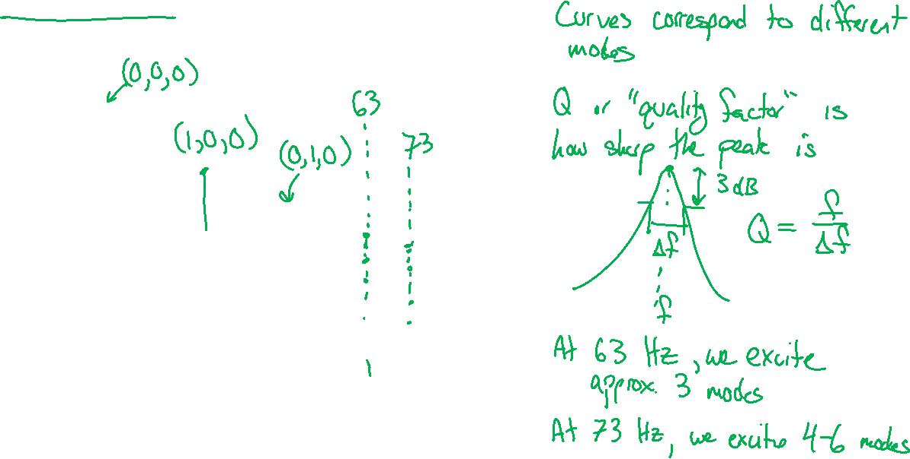
Modal excitation

Slide 16
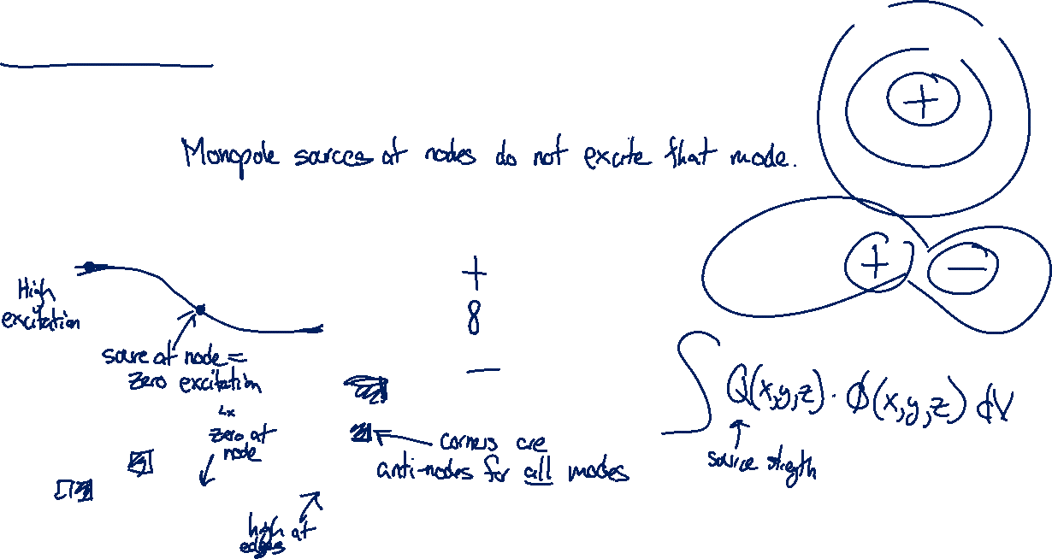
Modal excitation
Shape matching: how closely the source’s distribution matches the mode shape.
For monopole sources, this is just the value of the mode shape at that location.
For dipole sources, the gradient of the mode shape is what matters.
More complicated distributed sources are… more complicated.

Slide 17
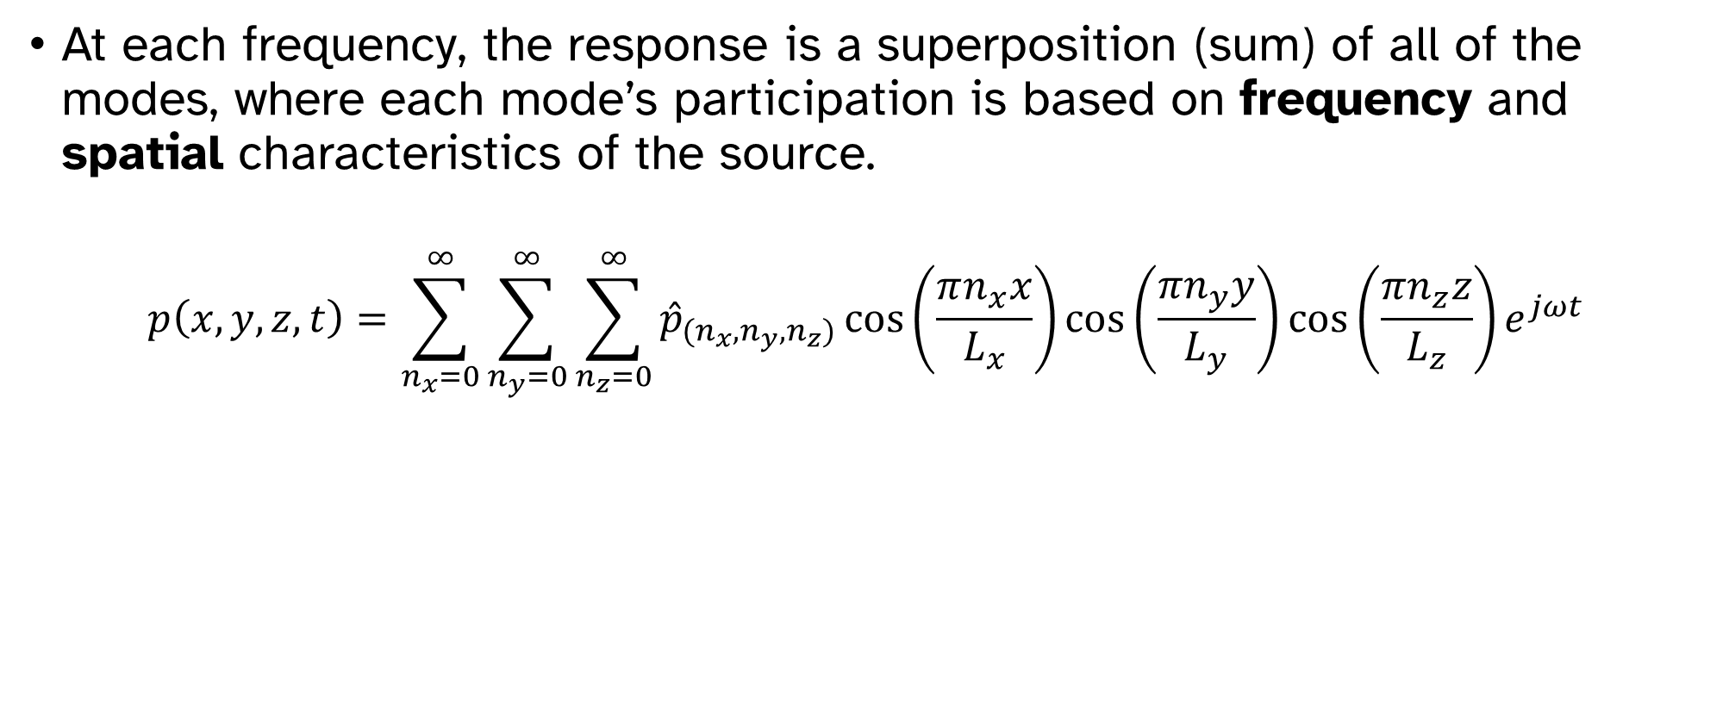
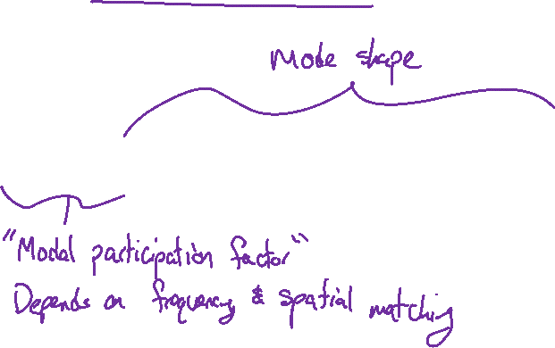
Modal excitation
At each frequency, the response is a superposition (sum) of all of the modes, where each mode’s participation is based on frequency and spatial characteristics of the source.
$$p\left(x,y,z,t\right)=\sum_{n_{x}=0}^{∞}{\sum_{n_{y}=0}^{∞}{\sum_{n_{z}=0}^{∞}{{\hat{p}}_{(n_{x}, n_{y},n_{z})}\cos\left(\frac{πn_{x}x}{L_{x}}\right)\cos\left(\frac{πn_{y}y}{L_{y}}\right)\cos\left(\frac{πn_{z}z}{L_{z}}\right)e^{jωt} }}}$$

Slide 18
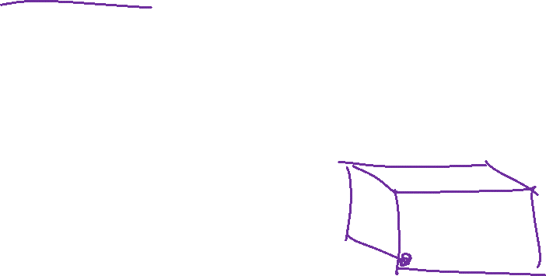
Modal excitation
The following animations show modal response for a source located at one corner of the room.
The corner is an anti-node of each of the modes.

Slide 19
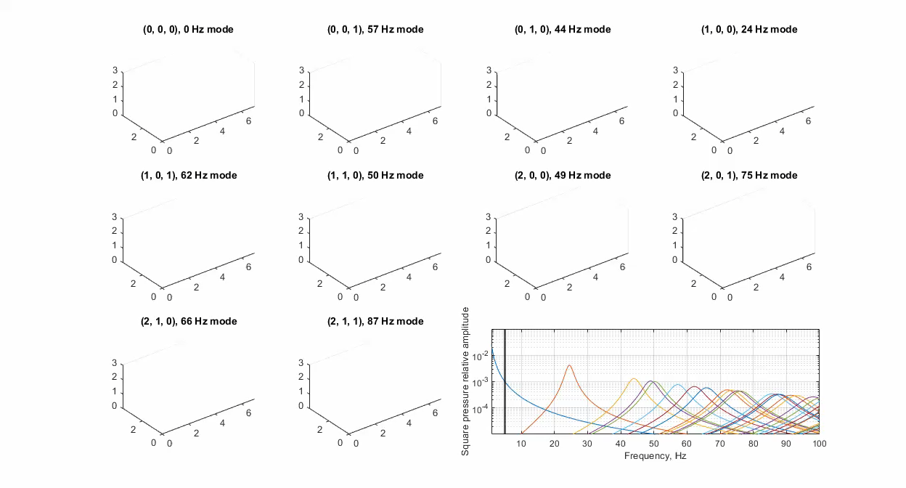
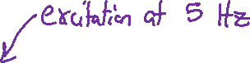

Slide 20
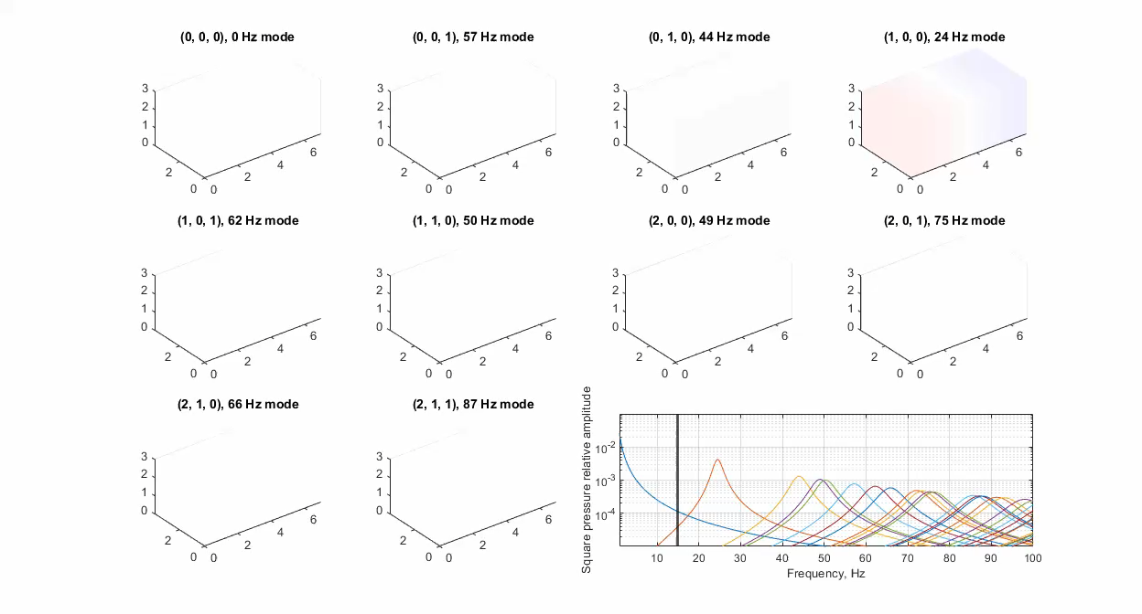
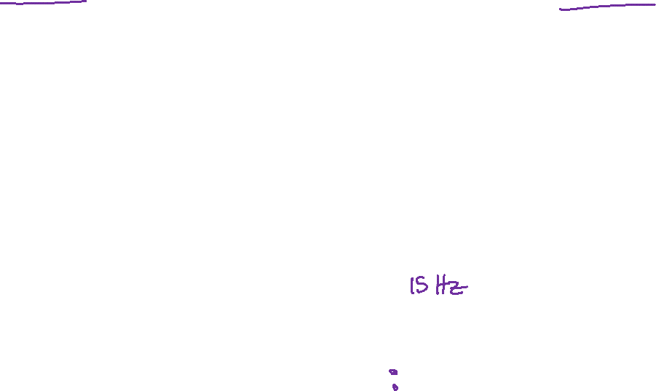

Slide 21
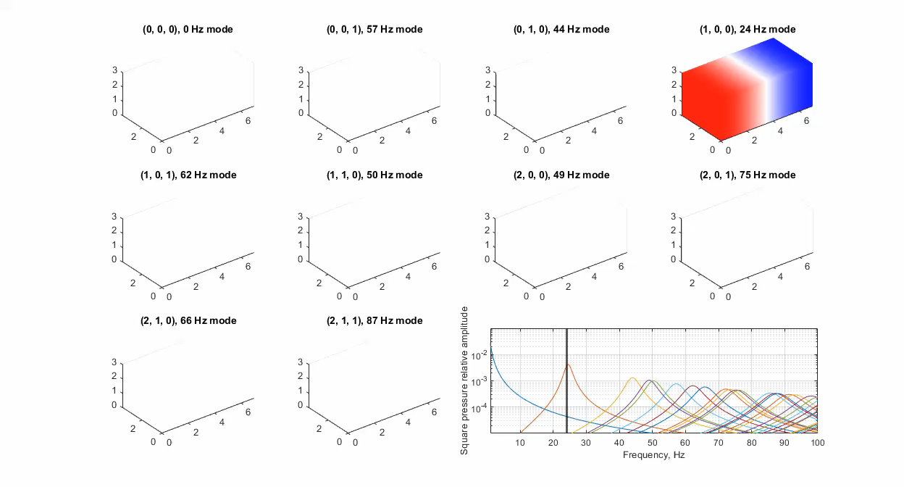
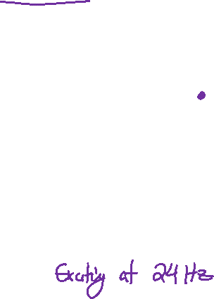

Slide 22
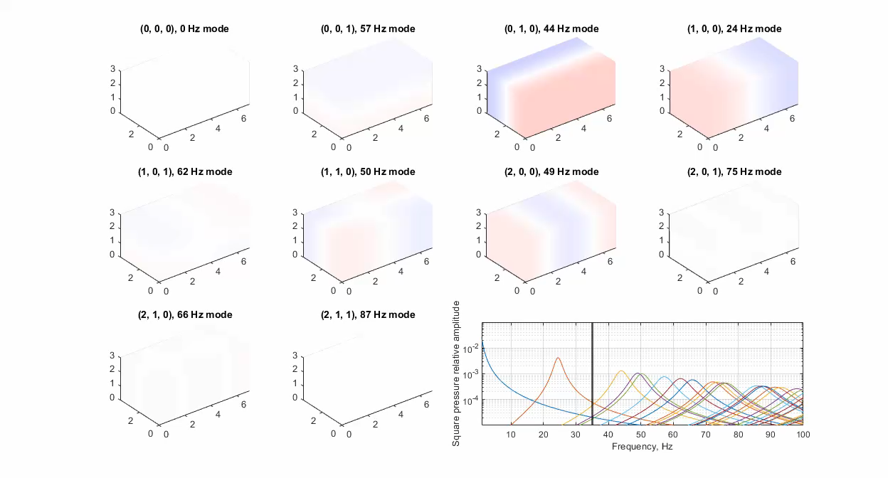

Slide 23
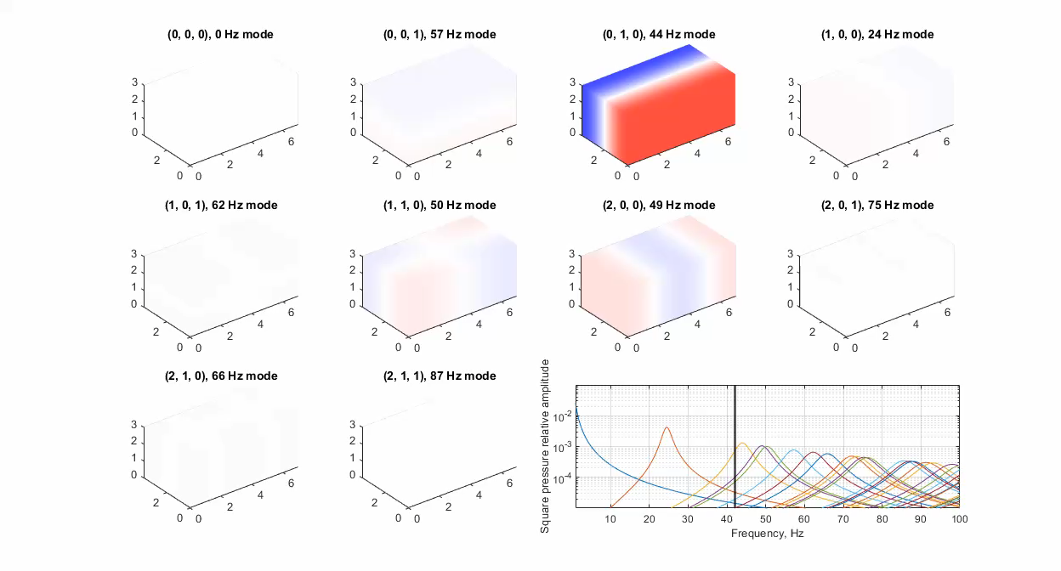

Slide 24
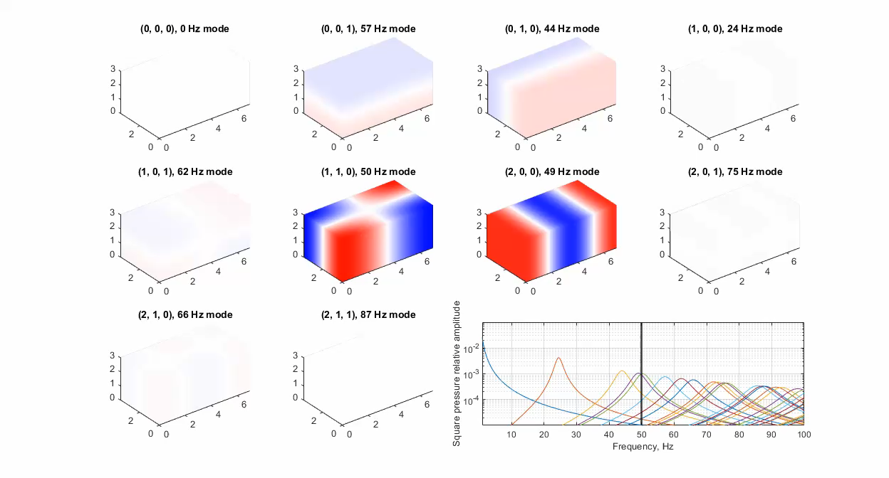

Slide 25
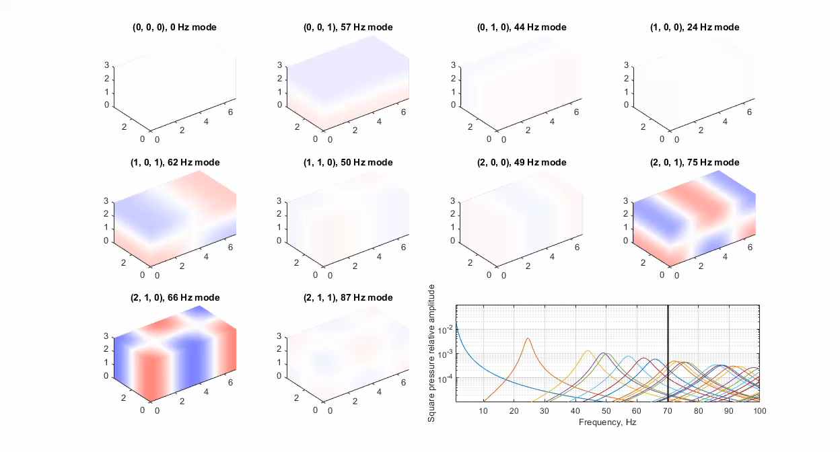
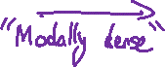

Slide 26
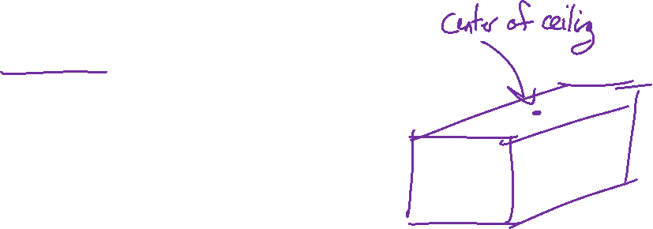
Source location
The following animations shows modal response for a source located at the center of the ceiling.
The center is a node for many of the modes.

Slide 27
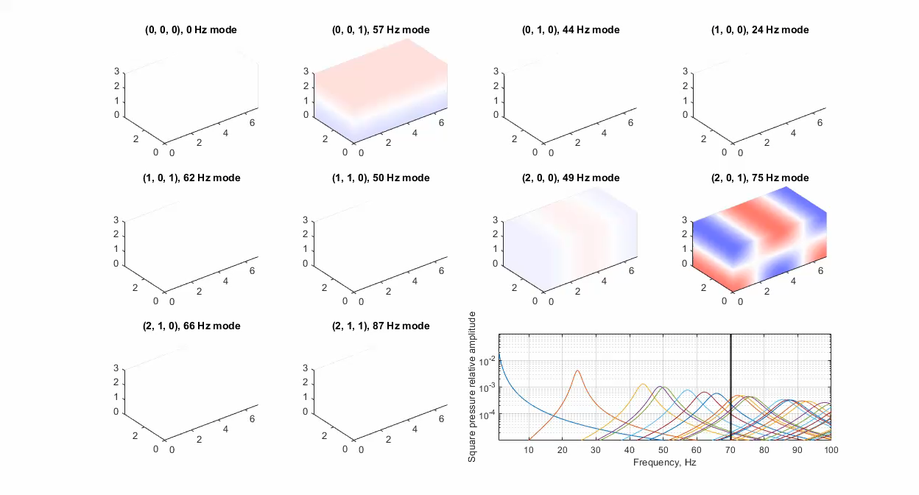
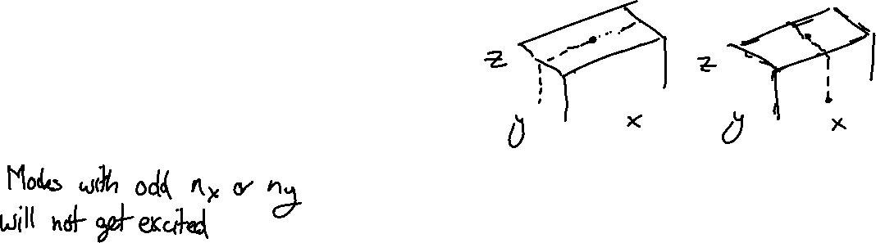

Slide 28
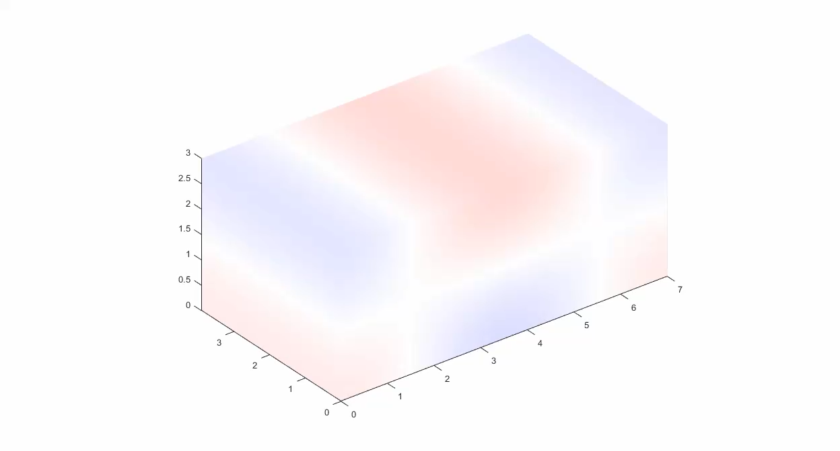
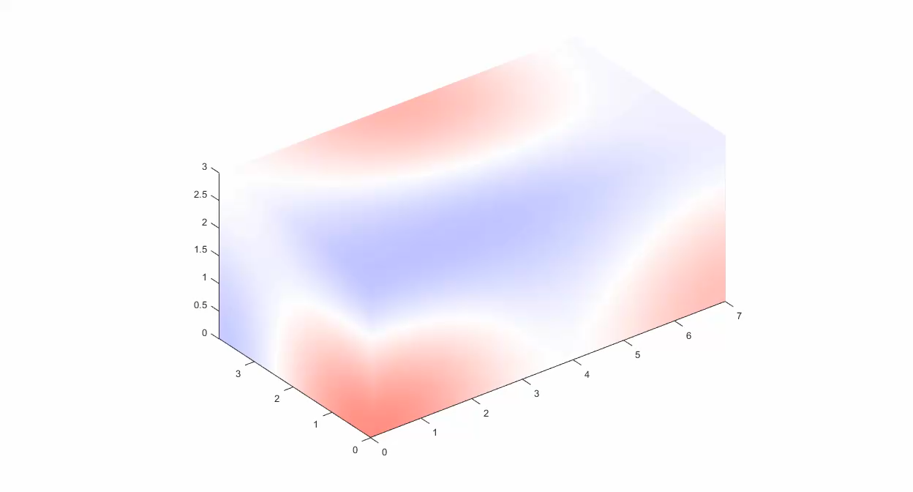

Modal superposition
The total response is the sum of all of the modes acting together.

Slide 29


National Institute for Occupational Safety and Health (NIOSH)

Slide 30


Modes for non-rectangular rooms
Modes in non-rectangular rooms
Introduce this program – it’s from COMSOL – put link on Canvas
A few gifs from this program

Slide 31





Modes for non-rectangular rooms

Slide 32




